Slide 1



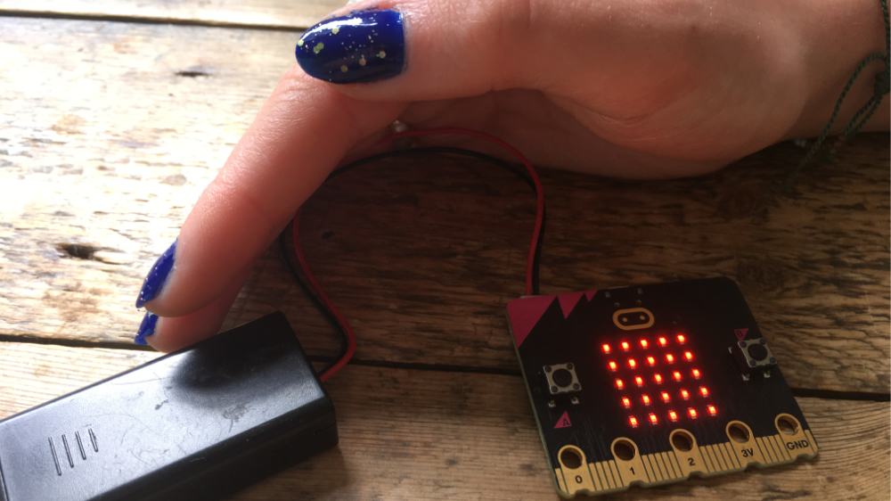


Lesson 5 Nightlight

Slide 2

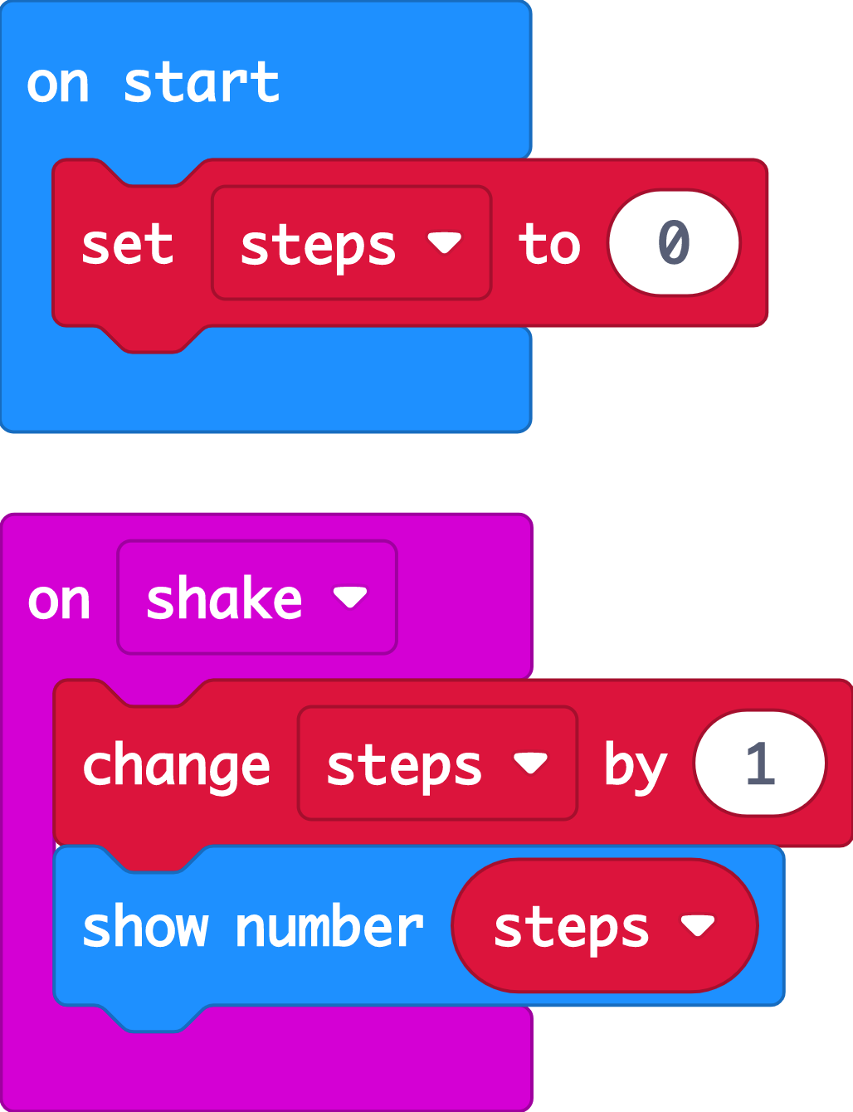
Recap: step counter
Last time we used the micro:bit’s accelerometer input sensor to make a step counter.
We used a variable to count how many steps we had taken.
We investigated how accurate the step counter was and thought about ways of improving it.
Today we’re going to use another sensor, the light sensor, to make a light that switches on automatically when it gets dark.

Slide 3

Introducing the light sensor
Notes:
This YouTube video explains
The micro:bit’s LEDs, as well as acting as an output, also can work as an input, sensing how dark or light it is
We can use this to make projects that react when it gets dark or light.

Slide 4





Think: learning objectives
I can code a micro:bit to make a light that switches on when it gets dark using sensors and logic.
I can explain that sensors are inputs that sense things in the real world, such as movement and light.
I can explain that logic is how computers make decisions in code based on whether things are true or false.
Notes:
Explain that Sensors are inputs that measure things outside a computer, like light, or movement. Logic is a key idea in computing. It helps machines to make decisions, like turning a light on if it’s dark.
Optional: play Nightlight introduction video which also explains that the micro:bit light sensor works in a range from 0 (very dark) to 255 (the brightest it can go).

Slide 5
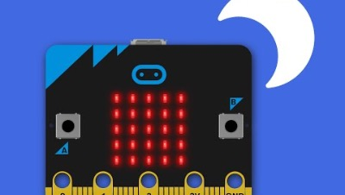



Think: night light introduction video
Optionally play video: https://youtu.be/6nWwnq8aYh8

Slide 6

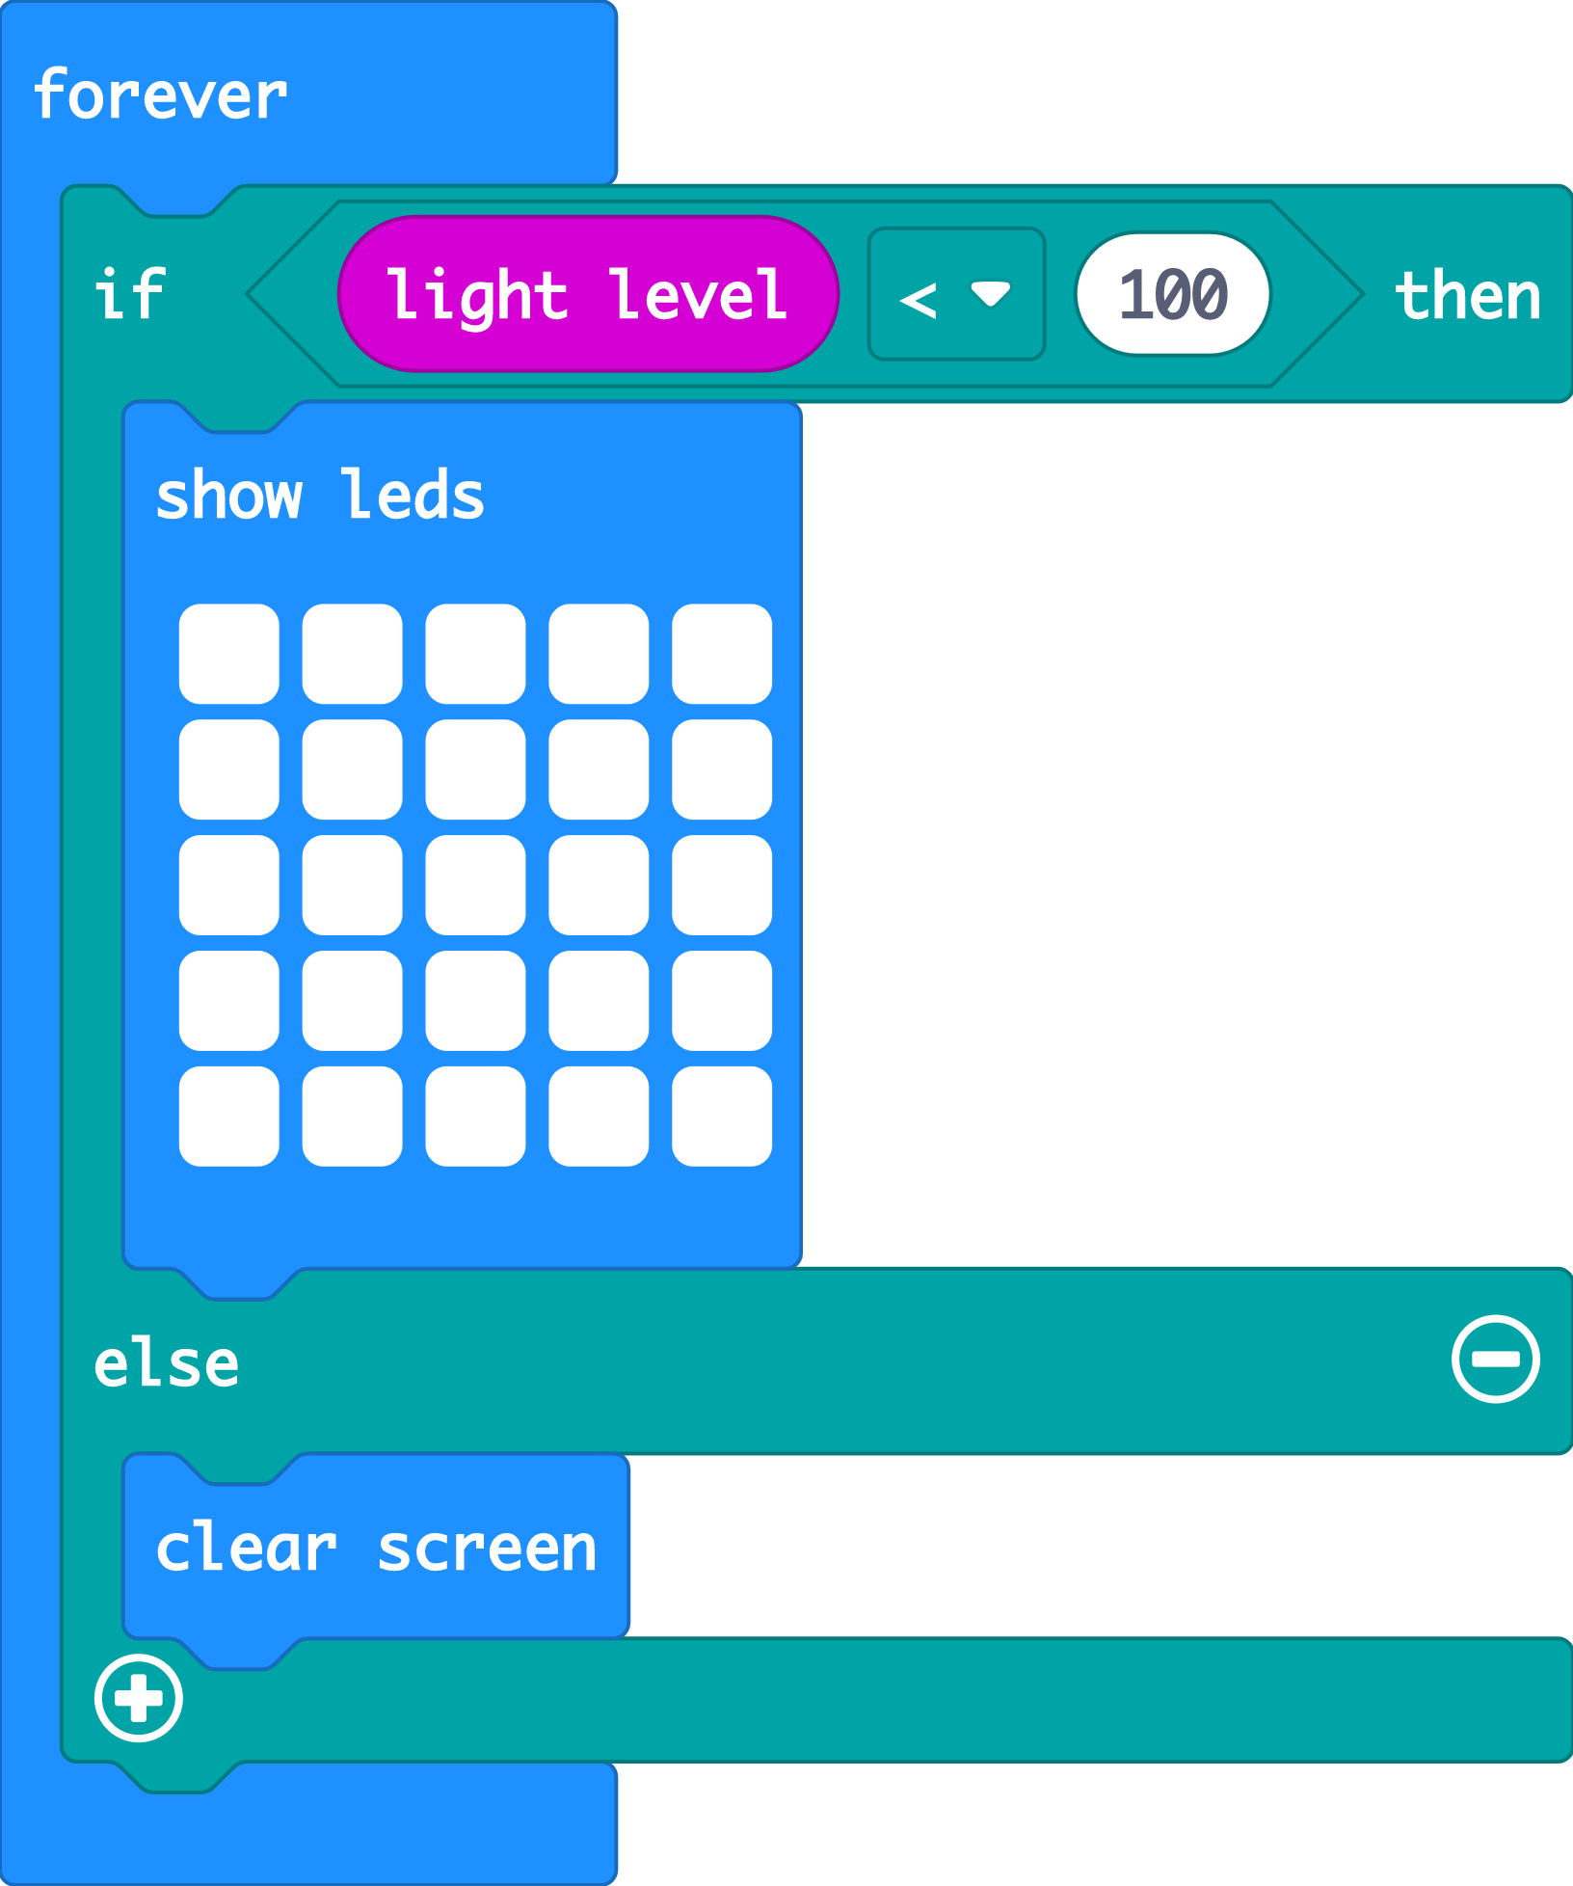

Create: examine the code
The ‘forever’ loop keeps the micro:bit checking the light level.
The logic ‘if… then’ block checks if the light level is low, less than (<) 100.
When the accelerometer input senses a shake, the ‘change’ block adds 1 to the number stored in the ‘steps’ variable.
Else (otherwise) the light level must be 100 or more. It must be light, so it turns the LEDs off with ‘clear screen’.
Teacher: open the completed code in the editor
Notes:
You can follow the link to open the completed code in the editor. Model testing it in the simulator by dragging the yellow line in the circle up and down on the micro:bit in the simulator.

Slide 7

Create: build the code
Open a new MakeCode project https://makecode.microbit.org/
Notes:
You can follow the link to open a new MakeCode project and model building the code yourself – or use slide 8 to show a YouTube coding video, or slide 9 to show an animated GIF of building the code if YouTube is blocked in your school.

Slide 8

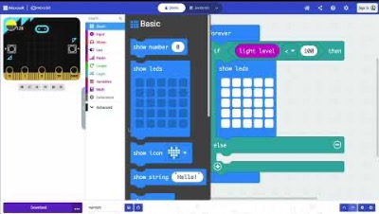
Create: coding video
Coding video: https://mbit.io/lessons-nightlight-code-video
Notes:
Optionally share this YouTube coding video with your class: https://mbit.io/lessons-nightlight-code-video

Slide 9


Create: coding animation
Notes:
Animated GIF of building the code you can share with your students, if YouTube is blocked in your school.

Slide 10
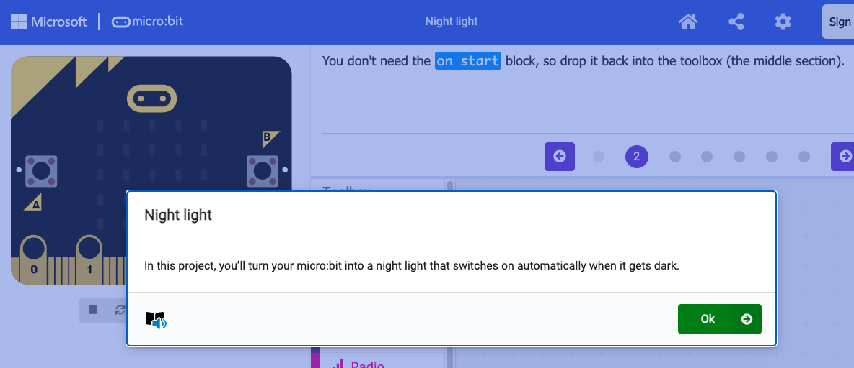
Create: step-by-step online tutorial
https://mbit.io/tutorial-night-light
Notes:
You can optionally share this online step-by-step tutorial with your students to follow individually.

Slide 11



Evaluate
Download your code to a micro:bit
Does it work as you expect? Use smaller numbers if the LEDs switch on too easily, or larger numbers if it’s hard to make the lights switch on.
How good is the project?
Could it have other uses?
How does it work?
Notes:
How good is the project?
Would you recommend it to a friend?
How could you improve it?
How does it work?
Encourage students to think about how it works when holding it in their hands.

Slide 12

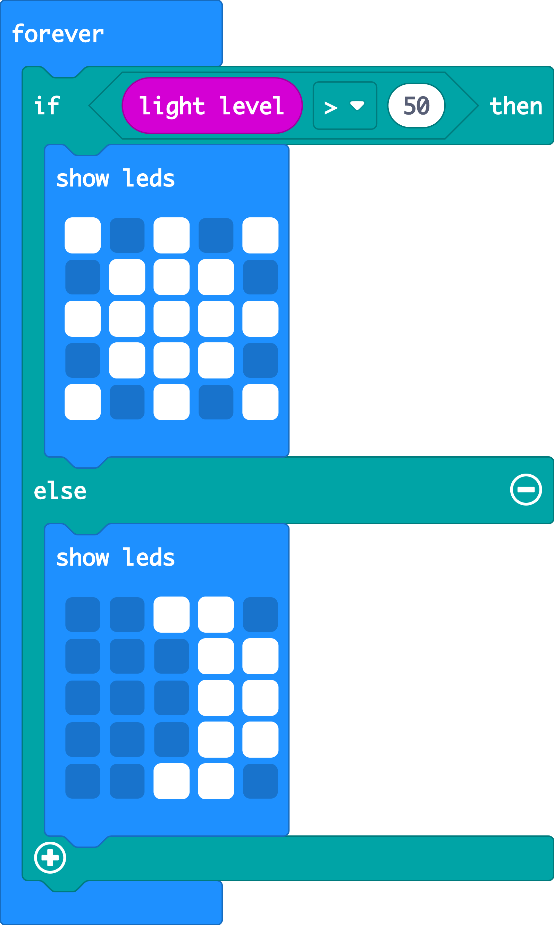


Extend
Make different pictures appear if it’s bright or dark.
You could experiment by changing the logic comparison block from less than < to greater than >
Notes:
Opportunity to reinforce mathematics learning about less than < and greater than > symbols.

Slide 13

Share: revisit the learning objectives
I can code a micro:bit to make a light that switches on when it gets dark using sensors and logic.
I can explain that sensors are inputs that sense things in the real world, such as movement and light.
I can explain that logic is how computers make decisions in code based on whether things are true or false.
Notes:
Ask:
What are sensors? How did you use them? (The LEDs work as an input, sensing light levels).
What is logic? How did we use it today? (We used logic to make a control system: if the light level is low, then we turn the lights on, else we turn them off.)
How did you test or improve your code? (Depending on the lighting conditions in your classroom, students may have had to use larger numbers to make the lights more sensitive – turn on when it’s brighter – or use smaller numbers to make them turn on only when it’s very dark.)

Slide 14

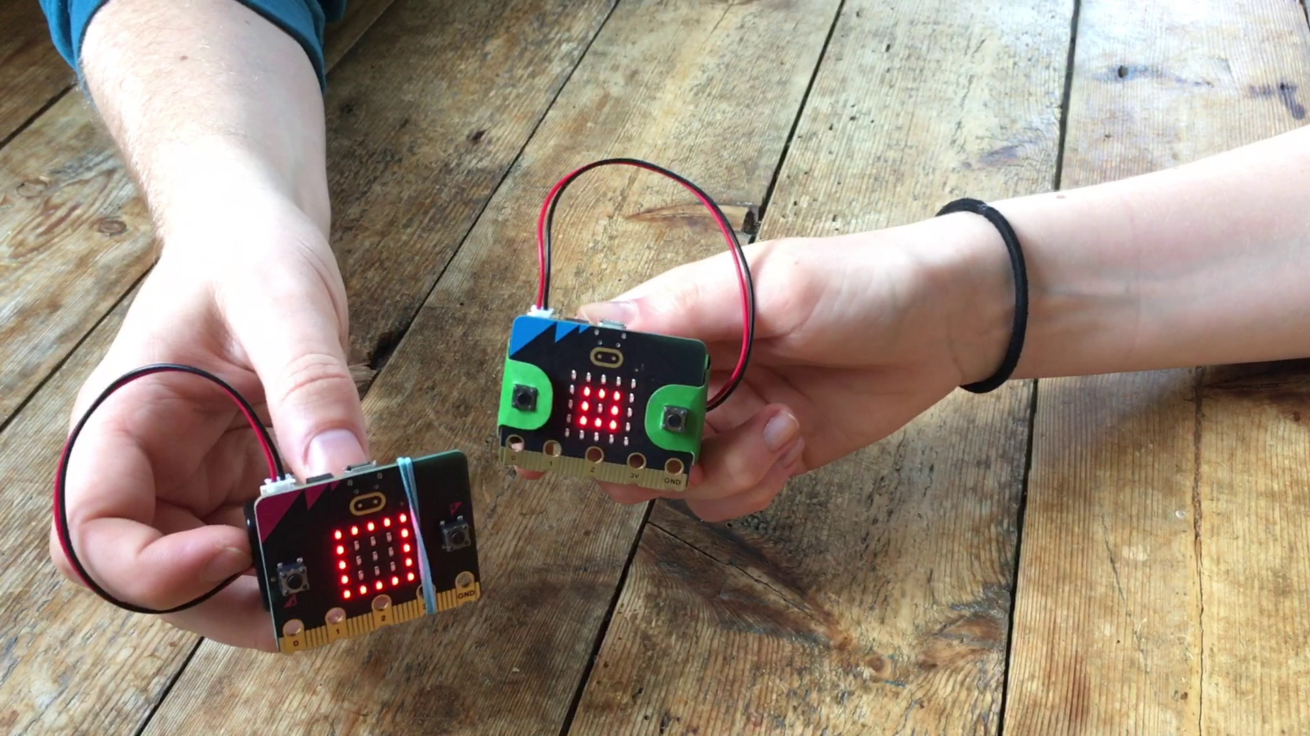
Next steps
Today we used the micro:bit light sensor and logic to turn LED lights on automatically when it gets dark.
Next time, we’ll use micro:bit sensors and logic to make a classic game of chance.

